Slide 1
HR ANALYTICS

Slide 2
Objectives
Thorough understanding of attrition trends
To identify patterns and potential factors that contribute to attrition.
Potential implications and strategies for addressing attrition.
Building dashboard- will elevate simple metrics by linking them to one another and visualizing as a whole

Slide 3
AGENDA
KPI 1- Average attrition rate for all departments
KPI 2- Average hourly rate of male research scientist
KPI 3- Attrition rate vs Monthly income stats
KPI 4- Average working years for each department
KPI 5- Job role vs Work life balance
KPI 6- Attrition rate vs Year since last promotion

Slide 4
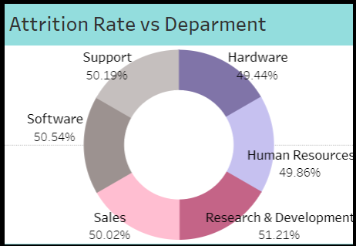
KPI 1- Average attrition rate for all departments
A consistent attrition rate across almost all departments.
This can be seen as a positive aspect, as it indicates that the organization is maintaining a certain level of employee satisfaction and engagement across the board.
Room for improvement in Research & Development and Software department.

Slide 5
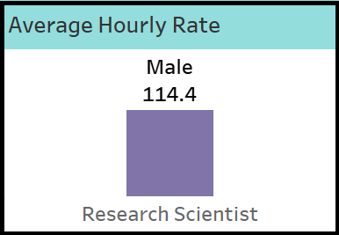
KPI 2- AVERAGE HOURLY RATE OF MALE RESEARCH SCIENTIST
Observation
Average hourly rate for all depart is almost similar.
For male research scientist is 114.45
Sales representative have lowest hourly rate.
Male have lowest hourly rate compared to women.
Lower the hourly rate, higher the attrition rate.
Conclusion
If we want to decrease the attrition rate, we will have to improve hourly rate for all departments.
In each department if the attrition rate is high and hourly rate is also high then improve the other aspects.

Slide 6
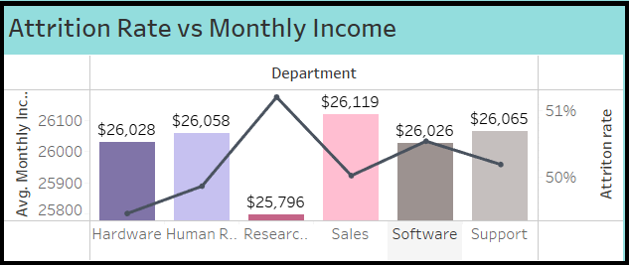
KPI 3- ATTRITION RATE VS MONTHLY INCOME STATS
Observation: Attrition rate show minor variation stepping 50% across monthly income bins, suggesting balanced turnover with consistent patterns but no clear linear correlation, visually depicted in the chart.
Possible reasons: Possible reasons for attrition include job dissatisfaction (roles, culture ,growth) market demand enticing better offers and potential salary concerns
Potential Changes: Recommended actions involve salary analysis for competitiveness, exit interview to uncover reasons and implementing retention program like career develops and mentorship

Slide 7
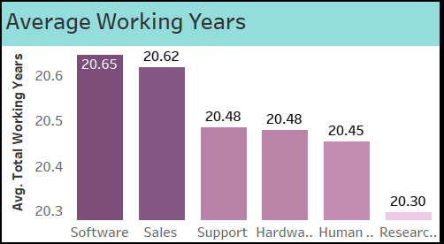
KPI 4- Average working years of each department
Due to rapid growth in salary and rapidly evolving technology younger generation prefer to spend more years in software.
R &D employees spend lesser years as very less people develop ability to research and develop new technologies
Working in Sales, employees receive additional commissions for their hard work. Their job involves interacting with their clients.
These differences in working years are also found due to industry trends, company practices and geographic location

Slide 8
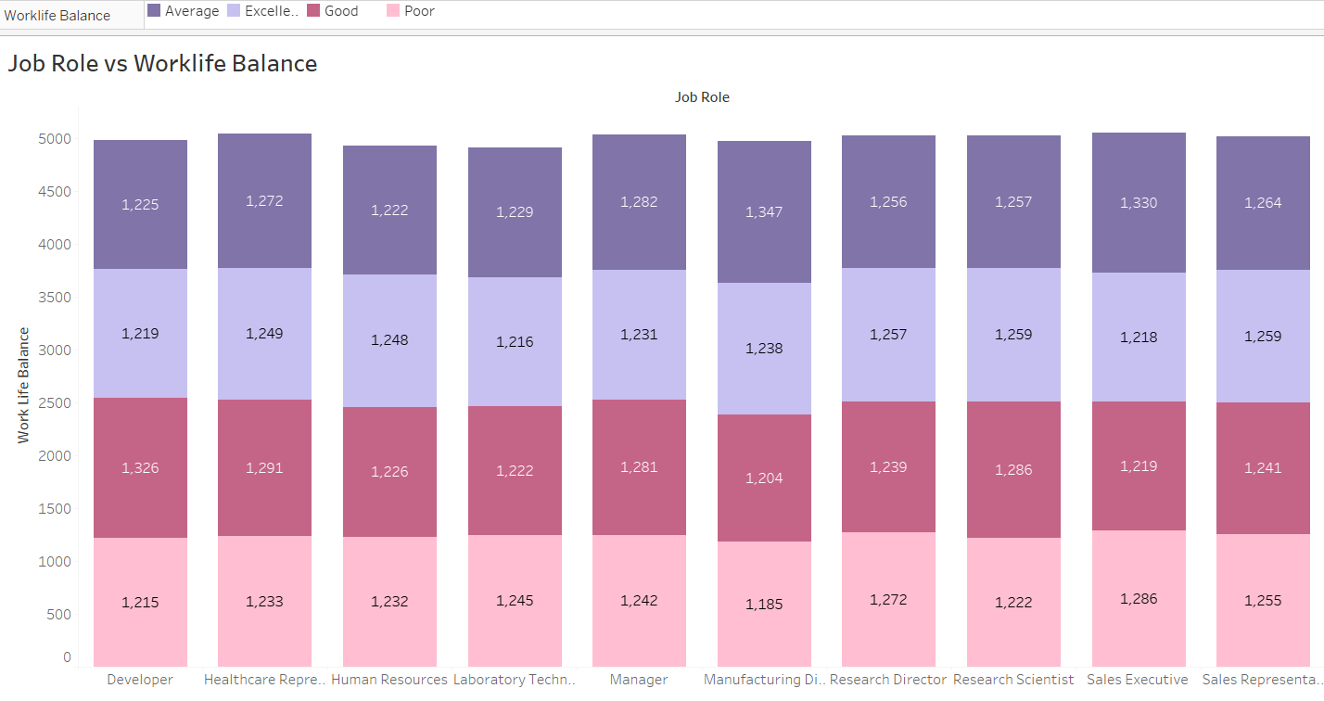
KPI 5- job role vs work life balance
As per our observation, the work life balance of all departments is approximately same except some departments.
In conclusion, the pursuit of a balanced life is not a compromise but a strategic investment. It's a recognition that personal growth, relationships, and rejuvenation are foundational to excelling in any job role.

Slide 9
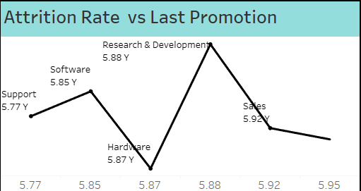
KPI 6- attrition rate vs year since last promotion
Observation: The attrition rates vary within a relatively narrow range, from around 49.18% to 51.50%. This suggests that the overall attrition rate is not drastically changing with the years since the last promotion.
Inconsistent Trend: At first glance, there isn't a clear linear or consistent trend in attrition rate as years since last promotion increase.
Other Factors: It might be worth considering other factors that could influence attrition, such as job role, department, Monthly Income, Work Life Balance, and overall job market conditions.
Conclusion: Even though there is no clear relation between attrition and years since last promotion and there may be other factors that could be influencing attrition like I mentioned above . We can conclude that employees getting promoted early are not leasing the company so company should promote employees within 10 years period to avoid employees leaving the company.

Slide 10
THANK YOU

